Slide 1
Business Functions and Performance Measures
Chapter 1, 4 (Baltzan)
McGraw-Hill/Irwin
Copyright © 2009 by The McGraw-Hill Companies, Inc. All rights reserved.

Slide 2
LEARNING OUTCOMES
Relate the strategic competitive with core competence and business functions
Define metrics and describe the relationship between efficiency and effectiveness metrics
Explain why a business would use metrics to measure the success of strategic initiatives
Notes:
A detailed review of the learning outcomes can be found at the end of the chapter in the textbook

Slide 3
The Value Chain and Strategic IS
View the firm as a chain of basic activities that add value to its products and services
Primary processes directly relate to manufacturing or delivering products
Support processes help support the day-to-day running of the firm and indirectly contribute to products or services
Use the value chain to highlight where competitive strategies will add the most value
2-3

Slide 4
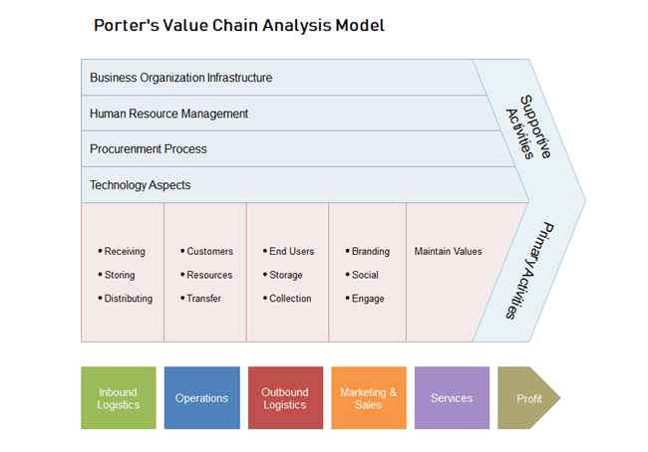
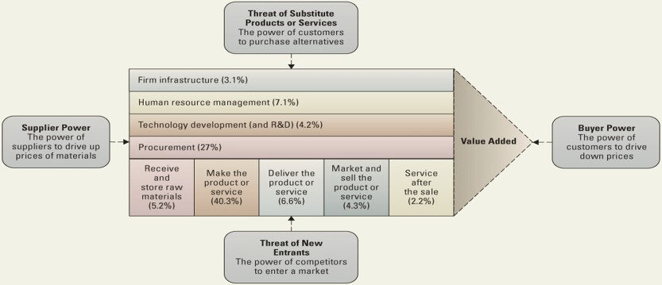
Porter’s Value Chain and 5-Force Model
Notes:
If an organization wants to decrease its buyer’s or customer’s power, it can construct its value chain activity of “service after the sale” by offering high levels of quality customer service
This will increase the switching costs for its customers, thereby decreasing their power (buyer power)

Slide 5
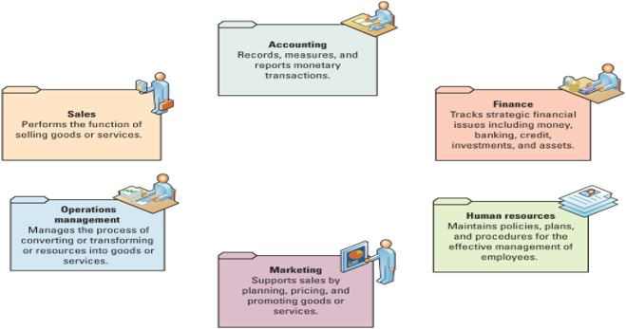
THE CHALLENGE: DEPARTMENTAL COMPANIES
Common Departments Working Interdependently!
Business Decision
Notes:
Ensure your students know what processes each department is responsible for performing
Ask your students to identify a few issues a company might encounter if its departments work independently
Data in and of itself is not useful unless the right people know how to use and manage it efficiently and effectively
People, information, and technology are inextricably linked
If one fails, they all fail
What is one of the most important assets in an organization?
Information is one of the most important assets in an organization, and the primary way that people get information is through information technology
Without databases and spreadsheets how would managers gather, correlate, and analyze information?
Manually
Performing these tasks manually, or by hand, is extremely time consuming

Slide 6
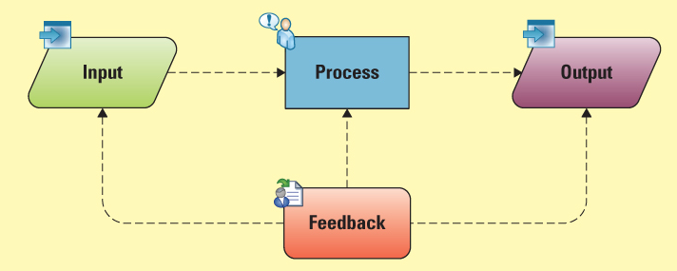
System thinking
Systems thinking – A way of monitoring the entire system by viewing multiple inputs being processed or transformed to produce outputs (common purpose) while continuously gathering feedback on each part
Notes:
Successful companies operate cross-functionally, integrating the operations of all departments. Systems are the primary enabler of cross-functional operations. A system is a collection of parts that link to achieve a common purpose. A car is a good example of a system, since removing a part, such as the steering wheel or accelerator, causes the entire system to stop working.
Systems thinking is a way of monitoring the entire system by viewing multiple inputs being processed or transformed to produce outputs while continuously gathering feedback on each part (see Figure). Feedback is information that returns to its original transmitter (input, transform, or output) and modifies the transmitter’s actions. Feedback helps the system maintain stability. For example, a car’s system continuously monitors the fuel level and turns on a warning light if the gas level is too low. Systems thinking provides us with an end-to-end view of how operations work together to create a product or service. Business students who understand systems thinking are valuable resources because they can implement solutions to problems that consider the entire process, not just a single component
System – A collection of parts that link to achieve a common purpose
Feedback – Information that returns to its original transmitter (input, transform, or output) and modifies the transmitter's actions
Ask your students to provide several real-world examples of systems thinking
Example: A car, coffee maker, washer and dryer, On Demand movies

Slide 7
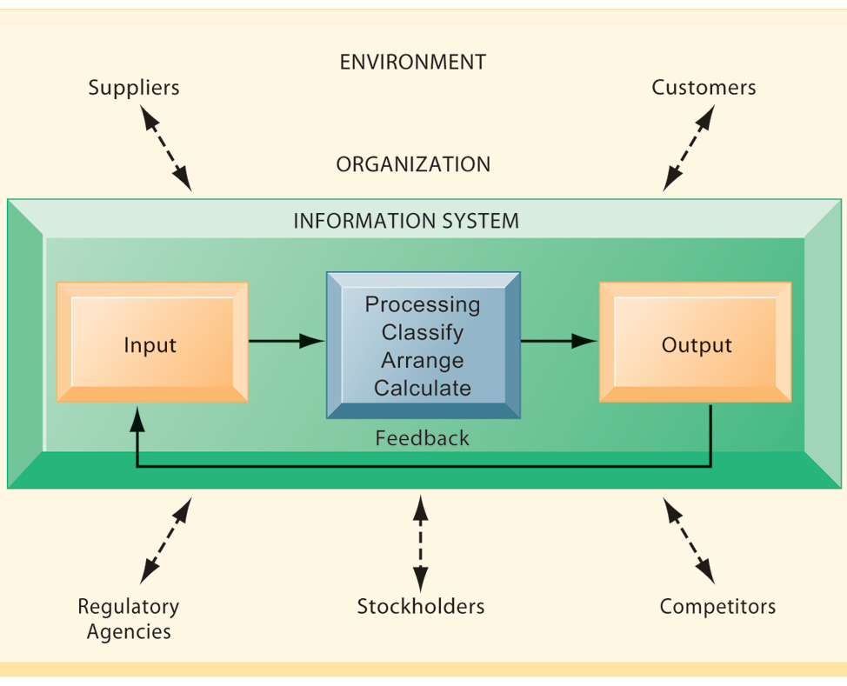
Functions of Information System
Feedback is info. about output returned to appropriate people or activities in the organization to evaluate and refine the input and process.

Slide 8
LEARNING OUTCOMES
Relate the strategic competitive with core competence and business functions
Define metrics and describe the relationship between efficiency and effectiveness metrics
Explain why a business would use metrics to measure the success of strategic initiatives
Notes:
A detailed review of the learning outcomes can be found at the end of the chapter in the textbook

Slide 9
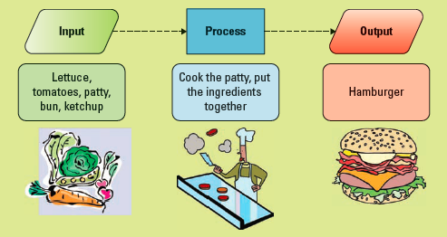
THE SOLUTION: BUSINESS INFORMATION SYSTEMS
How to measure the performance of our system?
Notes:
Production is the process where a business takes raw materials and processes them or converts them into a finished product for its goods or services.
Ask your students to explain the process of making a hamburger including:
Inputs - such as the bun, patty, lettuce, tomato, and ketchup
Process - cook the patty, wash and chop the lettuce and tomato, and place all of the items in the bun.
Outputs - your hamburger!
Productivity is the rate at which goods and services are produced based upon total output given total inputs.
Ask your students how a hamburger restaurant can improve productivity.

Slide 10
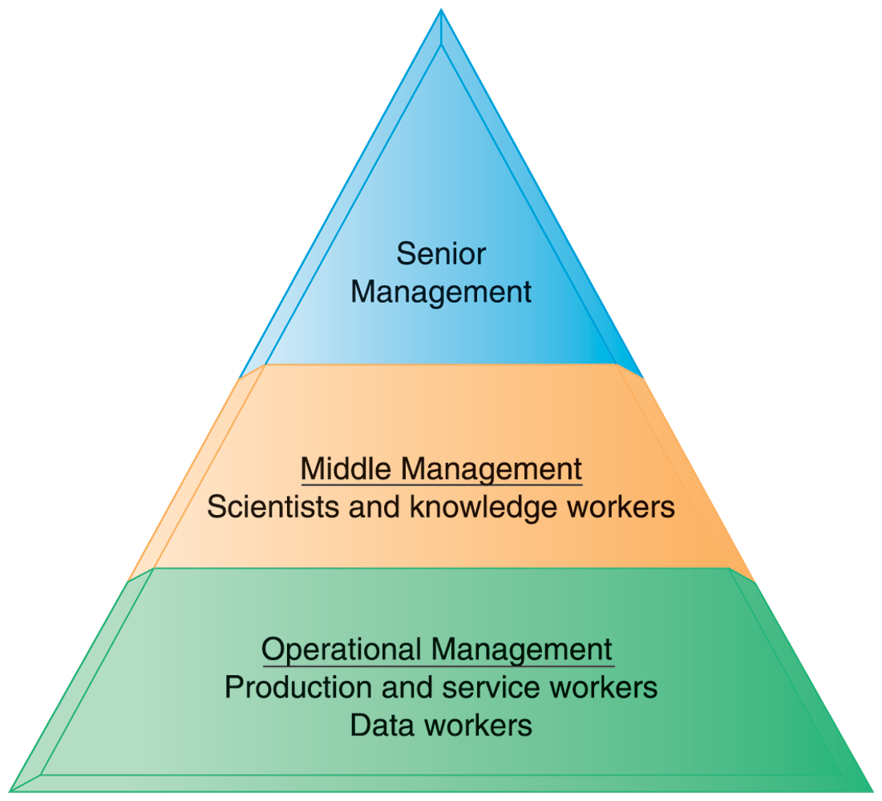
Organisation-- Levels in a Firm
Business organizations are hierarchies consisting of three principal levels:
senior management,
middle management, and operational management.
Information systems serve each of these levels.
Scientists and knowledge workers often work with middle management.
Notes:
Ask students to think about how information systems would factor into the day-to-day jobs of each of the three types of workers in the pyramid.

Slide 11
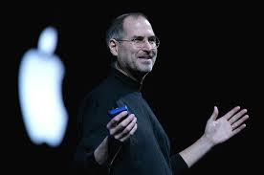
Perspectives on Information Systems
Management dimension of information systems
Managers set organizational strategy for responding to business challenges
In addition, managers must act creatively:
Creation of new products and services
Occasionally re-creating the organization
See how Steve Job organize Apple. https://www.youtube.com/watch?v=5hENFA3CJUY
Notes:
How might information systems assist managers in the development of new products and services? What is meant by re-creating the organization? Why do organizations need to be continually re-created? The answer is that they quickly become obsolete unless they continue to change. Ask students to help you list some organizations that have recently failed, or are about to fail.

Slide 12
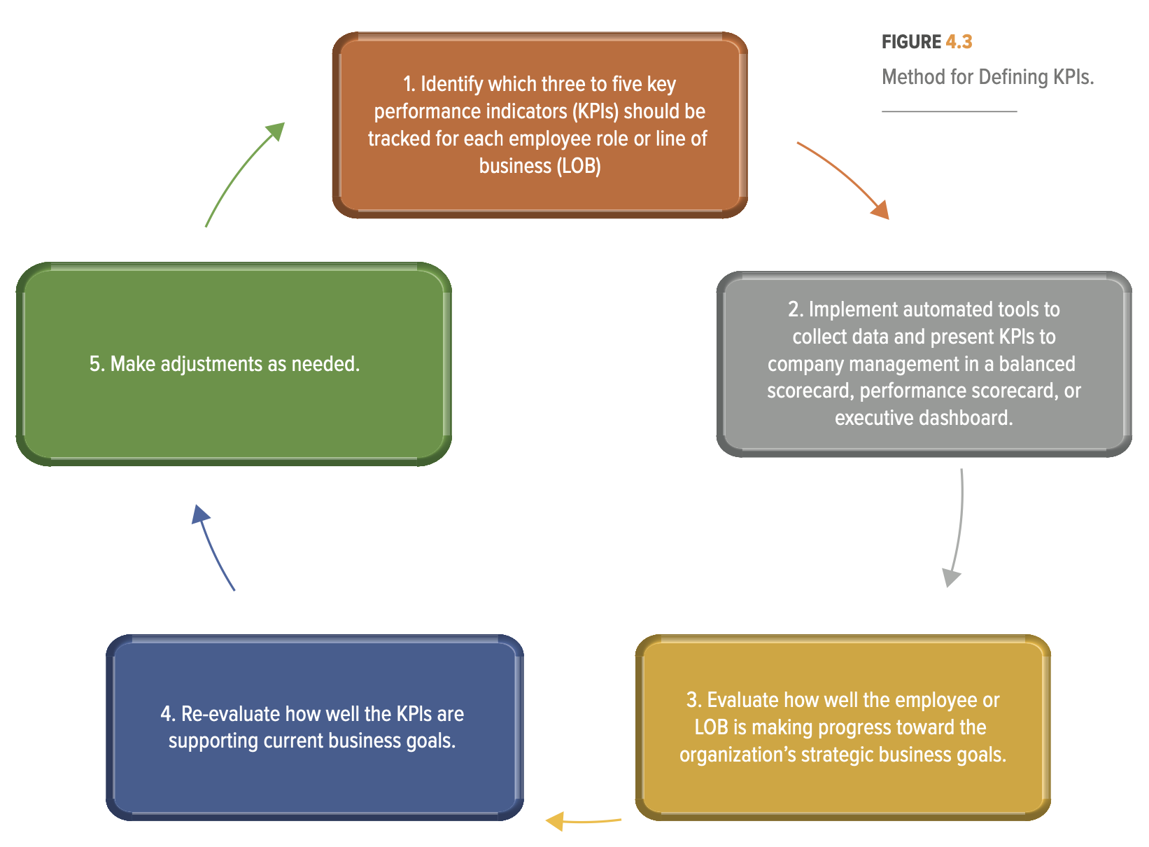
Business Performance Management: Cycle management by KPIs

Slide 13
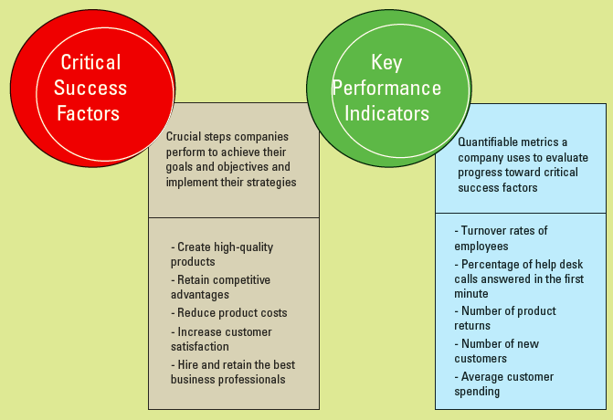
METRICS: MEASURING SUCCESS
http://www.kpilibrary.com
Notes:
Ask your students what categories would they list if they were writing their own personal CSFs?
Potential answers include:
Engage in Continuous Learning – Earn a Degree
Exercising and Practicing Healthy Habits
Building strong relationships and friendships

Slide 14
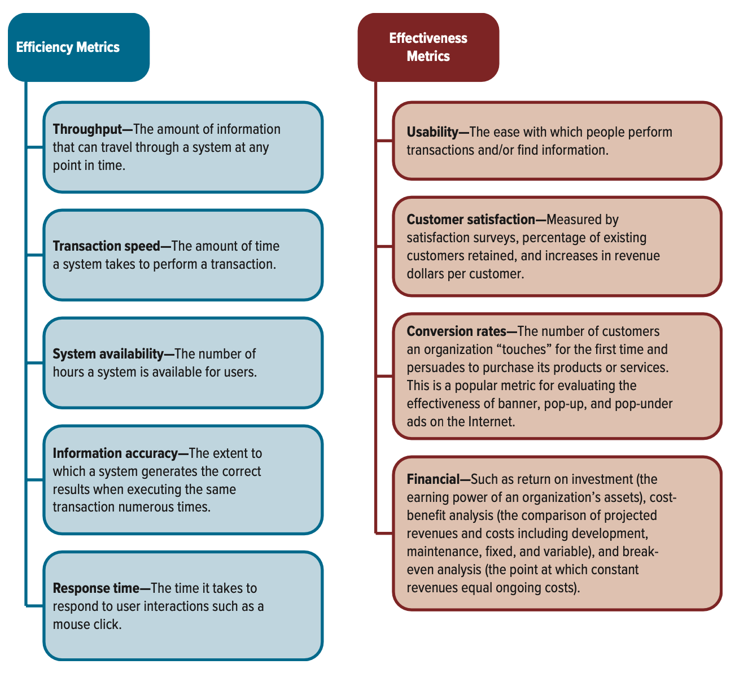
Efficiency and Effectiveness
Efficiency : Do the thing right
measures the performance of the system (OUTPUT):
Effectiveness : Do the right thing
measures the impact on business objectives (OUTCOME),
Notes:
Efficiency focuses on the extent to which an organization is using its resources in an optimal way, “Doing things right”
Effectiveness focuses on how well an organization is achieving its goals and objectives, “Doing the right things”
It is important that your students understand the differences between efficiency and effectiveness if you are going to cover the Business Plug-In for Supply Chain Management. This plug-in deals with efficient vs. effective supply chains.

Slide 15
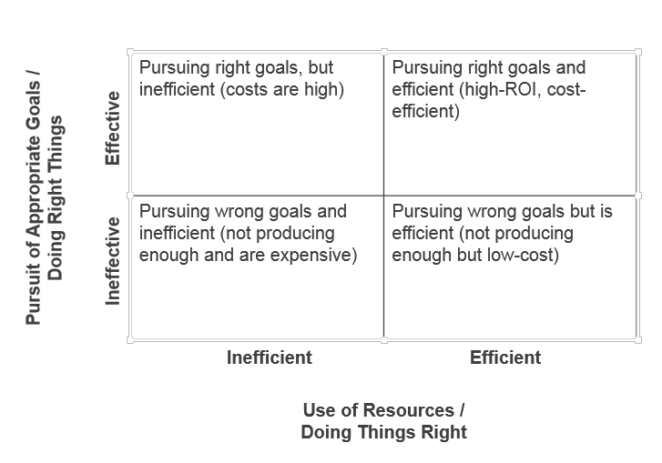
The Interrelation of Efficiency and Effectiveness MIS Metrics
https://www.insightsquared.com/blog/effectiveness-vs-efficiency-whats-the-difference/
Notes:
Ideally, an organization should operate in the upper right-hand corner
Operating in the upper left-hand corner or the lower right-hand corner may be in line with an organization's particular strategies
No organization would want to operate in the lower left-hand corner

Slide 16
Sample cases for Efficiency vs Effectiveness The IT department has been asked for a pitch and demo to give the audience a firsthand experience of its functionality/benefits.
The team built a state-of-the-art demo and deck, but it takes them 2 weeks. The customer is dissatisfied with how much time it took to hear back from your team.
The team has a clear workflow in place and is able to build a deck and demo in 5 days. the client decides to move forward with your product!
The team hasn’t built a good out working processes, so no one is clear on who’s doing what! The team is able to scrape something but it doesn’t speak to the value
The team builds a deck and demo in just 3 days. But once they present, the potential client is dissatisfied because the content focused on the wrong things.

Slide 17
LEARNING OUTCOMES
Relate the strategic competitive with core competence and business functions
Define metrics and describe the relationship between efficiency and effectiveness metrics
Explain why a business would use metrics to measure the success of strategic initiatives
Notes:
A detailed review of the learning outcomes can be found at the end of the chapter in the textbook

Slide 18
MEASURING ENTERPRISE SUCCESS
Balanced scorecard – Enables organizations to clarify their vision and strategy and translate them into action
Balanced scorecard views the organization from four perspectives
Learning and growth
Internal business process
Customer
Financial
Notes:
The value of metrics is in their ability to provide a factual basis for defining:
Strategic feedback to show the present status of the organization from many perspectives for decision makers.
Diagnostic feedback into various processes to guide improvements on a continuous basis.
Trends in performance over time as the metrics are tracked.
Feedback around the measurement methods themselves and which metrics should be tracked.
Quantitative inputs to forecasting methods and models for decision support systems

Slide 19
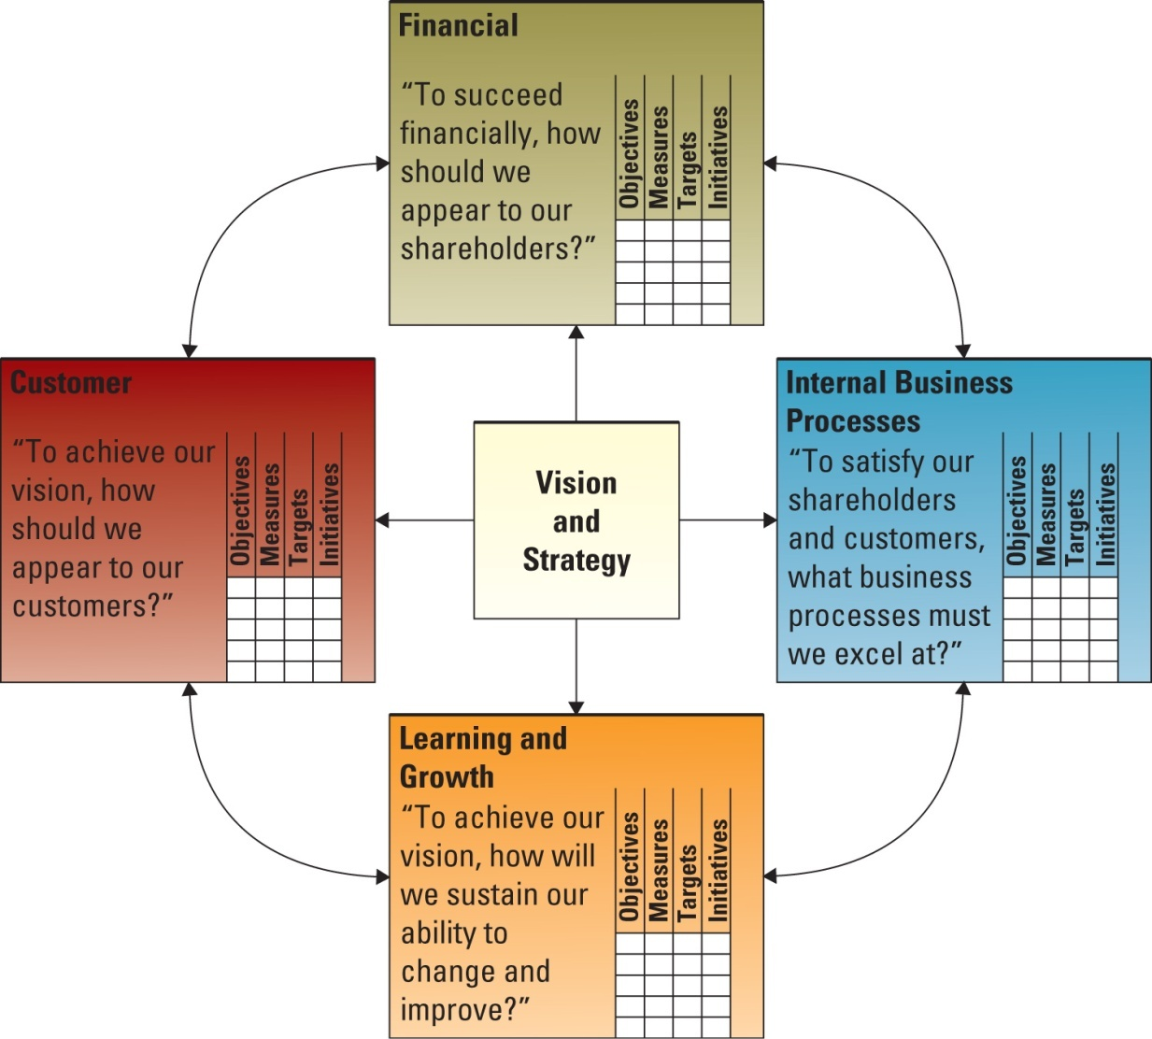
BSC as a Business Performance METRICS
Notes:
The balanced scorecard is a management system, (in addition to a measurement system), that enables organizations to clarify their vision and strategy and translate them into action. It provides feedback around both the internal business processes and external outcomes in order to continuously improve strategic performance and results. When fully deployed, the balanced scorecard transforms strategic planning from an academic exercise into the nerve center of an enterprise
The balanced scorecard views the organization from four perspectives, and users should develop metrics, collect data, and analyze their business relative to each of these perspectives:
The learning and growth perspective.
The internal business process perspective.
The customer perspective.
The financial perspective

Slide 20
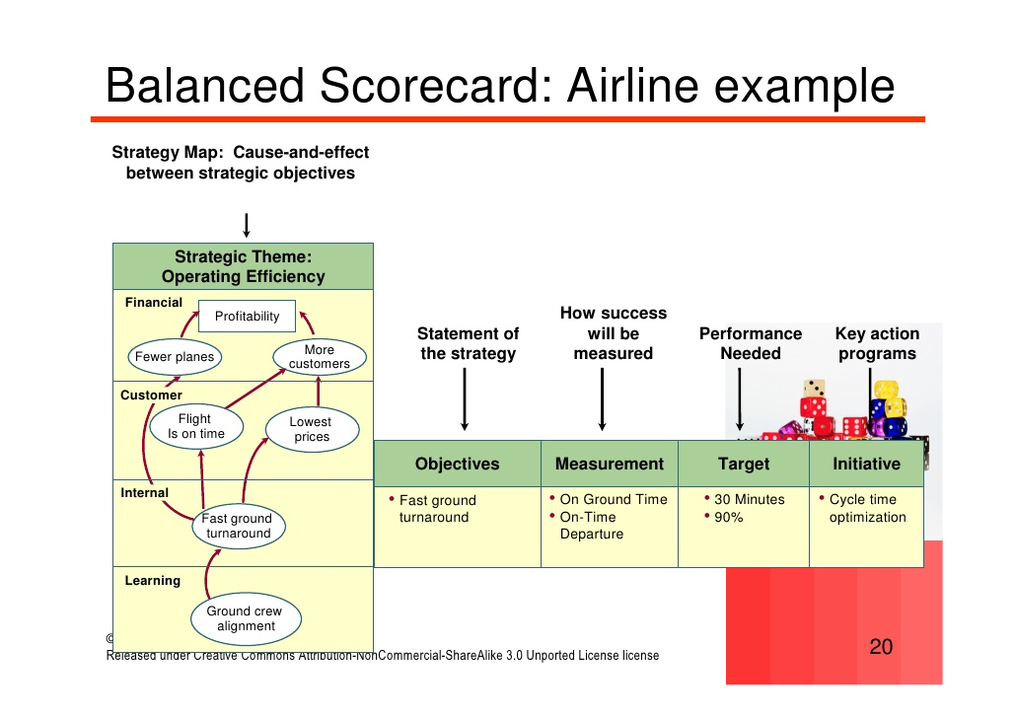
https://en.wikipedia.org/wiki/Aircraft_ground_handling

Slide 21
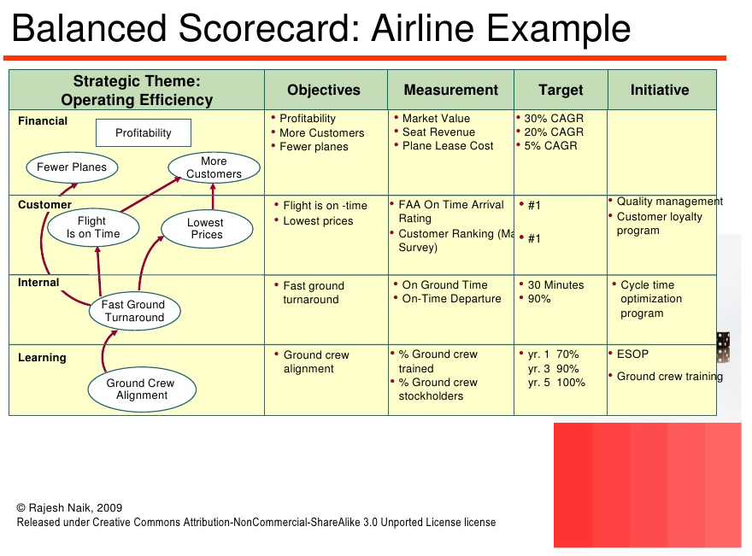
Source: http://image.slidesharecdn.com/orgalignmentstrategymapsbsc-100704001800-phpapp02/95/organizational-alignment-using-strategy-maps-and-balanced-scorecard-22-728.jpg?cb=1278202909
Notes:
ESOP = Employee Stock Ownership Plan
CAGR = Compound Annual Growth Rate
FAA = Federal Aviation Administration

Slide 22
Conclusion
BIS –Using IT for enhancing values to business in a systematic way.
We have learnt two main metrics: CSF and KPI.
Effective and Efficient measures and interrelation
BSC for Enterprise Performance Management system

Slide 23
Attachment
Traditional functional organization versus a new paradigm in Apple Corp. https://www.youtube.com/watch?v=5hENFA3CJUY
Balanced ScoreCard with Strategy Map https://www.youtube.com/watch?v=3vjpZO-DP7g

